Slide 1
Prototyping
Communicating Ideas

Slide 3
Introduction
Prototypes can be used to communicate ideas to our stakeholders
Cheaper to fail earlier

Slide 4
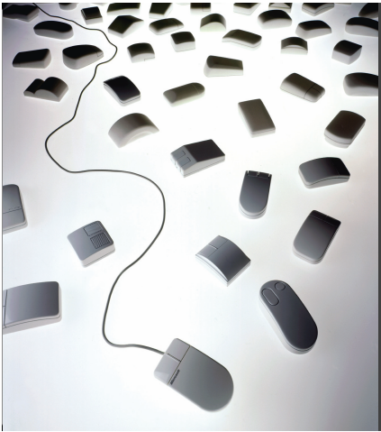
Microsoft Mouse
Designers may build dozens of prototypes to get a more complete understanding of a design space
For example, Paul Bradley at IDEO built about eighty foam models for the original Microsoft mouse to quickly explore different directions

Slide 5
Use Stage-Appropriate Tools
Fidelity
Time
Notes:
Story boarding given you a sense of tasks involved

Slide 6
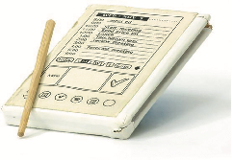
What is a prototype?
One manifestation of a design that allows stakeholders to interact with it
In other design fields, a prototype is a small-scale model:
A miniature car
A miniature building or town
Source: PalmPilot wooden model © Mark Richards

Slide 7
What is a prototype in interaction design?
In interaction design, a prototype can be (among other things):
A series of screen sketches
A storyboard, for example, a cartoon-like series of scenes
A PowerPoint slide show
A video simulating the use of a system
A lump of wood (for instance, the PalmPilot)
A cardboard mock-up
A piece of software with limited functionality written in the target language or in another language

Slide 8
Prototyping Types
Low Fidelity
High Fidelity

Slide 9
Low Fidelity Prototyping
Storyboards
Wireframes
Sketching
Card Based

Slide 10
Story Boarding
A storyboard is a series of frames that visually describe a users experience with the product.
We are now focused on solution to the users problem.
Story boarding is all about tasks
It doesn’t focus on the actual user interface but how would people be using this.
Don’t worry if you can’t draw
Its not about beautiful drawings but conveying ideas

Slide 11
Storyboards-Types
Big Picture Storyboards
Focus on How and Why
Think about
How will the user use out application
Why would it be useful
Why would the user be delighted by our application
Close-up Storyboards
Focus is on What
Its less about emotion
Focus on the design itself
Early in the design Big Picture Storyboards are more useful

Slide 12
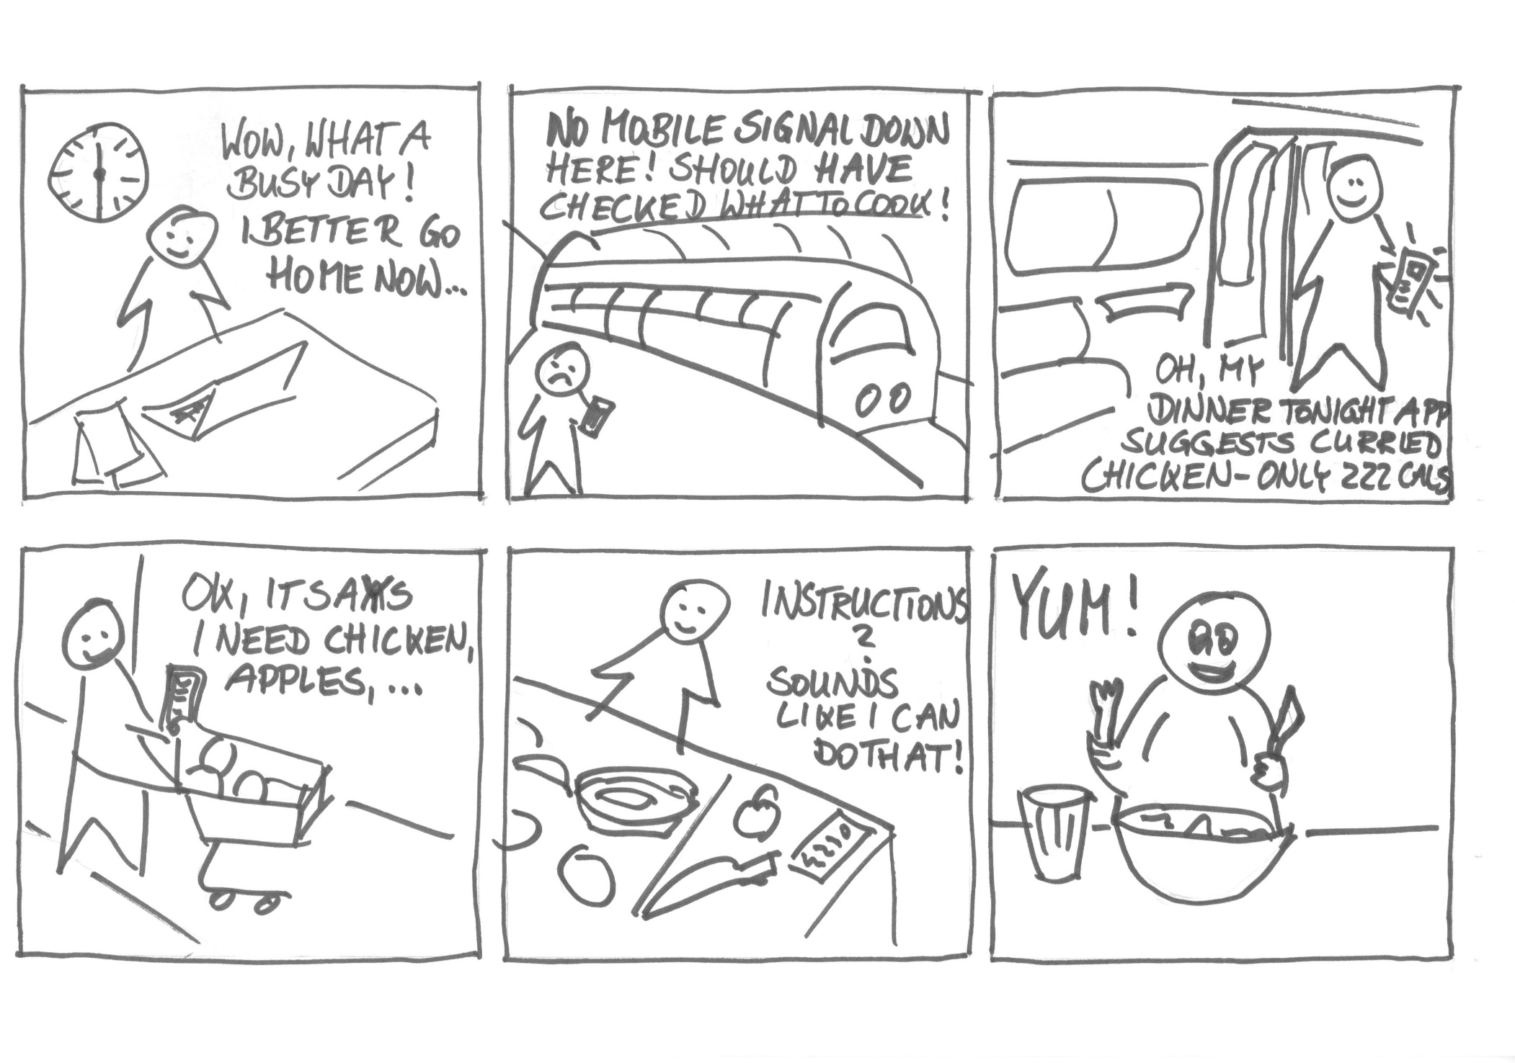
Big Picture Storyboard

Slide 13
Problem Statement
Peter is an online teacher who enjoys movie theaters during weekends but is pretty difficult to go to because he could not find movie theater apps to reserve a seat for his wheelchair space and special needs.
https://jjgarrido.com/case-study-mts-cinema/

Slide 14
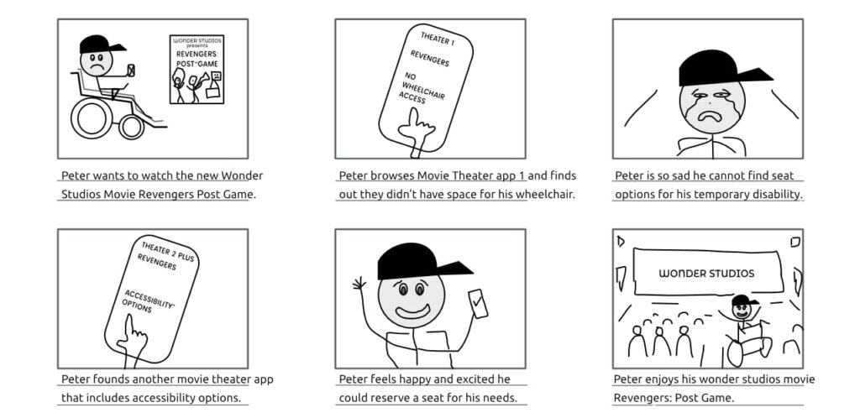
Big Picture Storyboard
https://jjgarrido.com/case-study-mts-cinema/

Slide 15
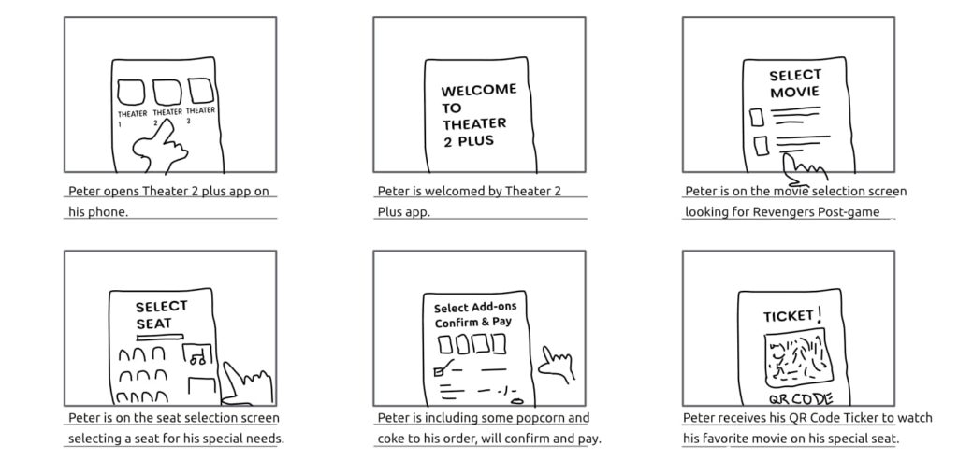
Close-up Storyboard
https://jjgarrido.com/case-study-mts-cinema/

Slide 16
Story boards should convey
Setting
People involved
Environment
Task being accomplished
Sequence
What steps are involved?
What leads someone to use the app?
What task is being illustrated?
Satisfaction
What’s motivates people to use this system?
What does it enable people to accomplish?
What need does the system fill?

Slide 17
Storyboarding
…should be quick.
Should set strict time limit on yourself (Around 10 mins)

Slide 18
Benefits of Storyboarding
Holistic focus: Helps emphasize what an interface accomplishes a task
Avoids commitment to a particular user interface (no buttons yet)
Helps get all the stakeholders on the same page in terms of the goal

Slide 19
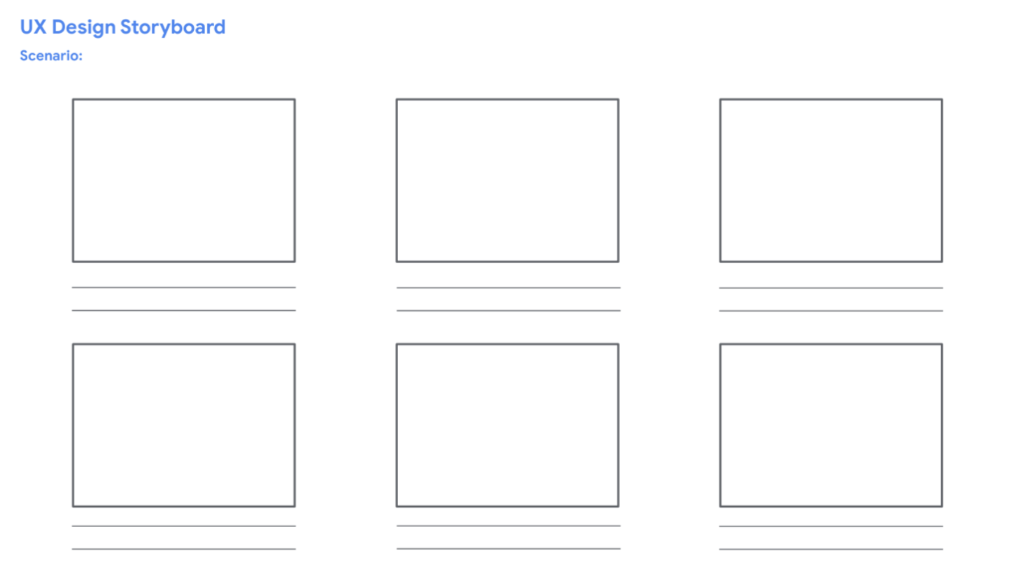

Slide 20
Wireframes
A basic outline of a digital experience, like an app or a website
They are mostly lines and frames with some text.
They are useful for creating the basic structure of a page
How to organize information on the page
How the elements serve the overall functionality
They help save time and resources by allowing designers to quickly look at alternatives

Slide 21
Wireframes
Wireframes are made up of elements
The main elements to draw wireframes are lines, rectangles and circles and text
Texts is usually represented by horizontal lines
Images by circles
Call to action button like a submit button by a rectangle

Slide 22
Sketching and Card Based prototypes
After you have gotten a clear idea about what your application should accomplish you can start thinking about how you will accomplish that.
Again it shouldn’t take too much time.
You can mix and max fidelities (mixture of screen shots and hand drawings)

Slide 23
Sketching
Low-fidelity prototyping often relies on sketching
Don’t be inhibited about drawing ability — Practice simple symbols
14

Slide 24
Prototyping with index cards
Index cards (3 x 5 inches)
Each card represents one element of interaction
In evaluation, can step through the cards
15

Slide 25
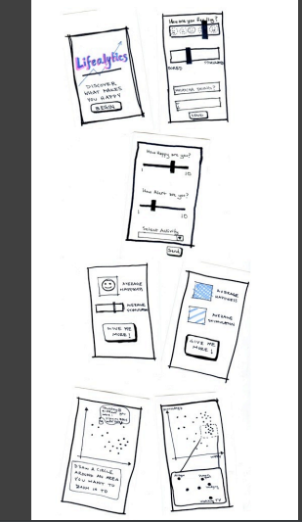

Slide 26
Remember to try out multiple alternative prototypes simultaneously

Slide 27
Strengths of Paper prototypes
Anyone can do it.. You can involve users by asking them to make any changes they want
It helps you to focus on what's important early on, without going into details such as color schemes and fonts

Slide 28
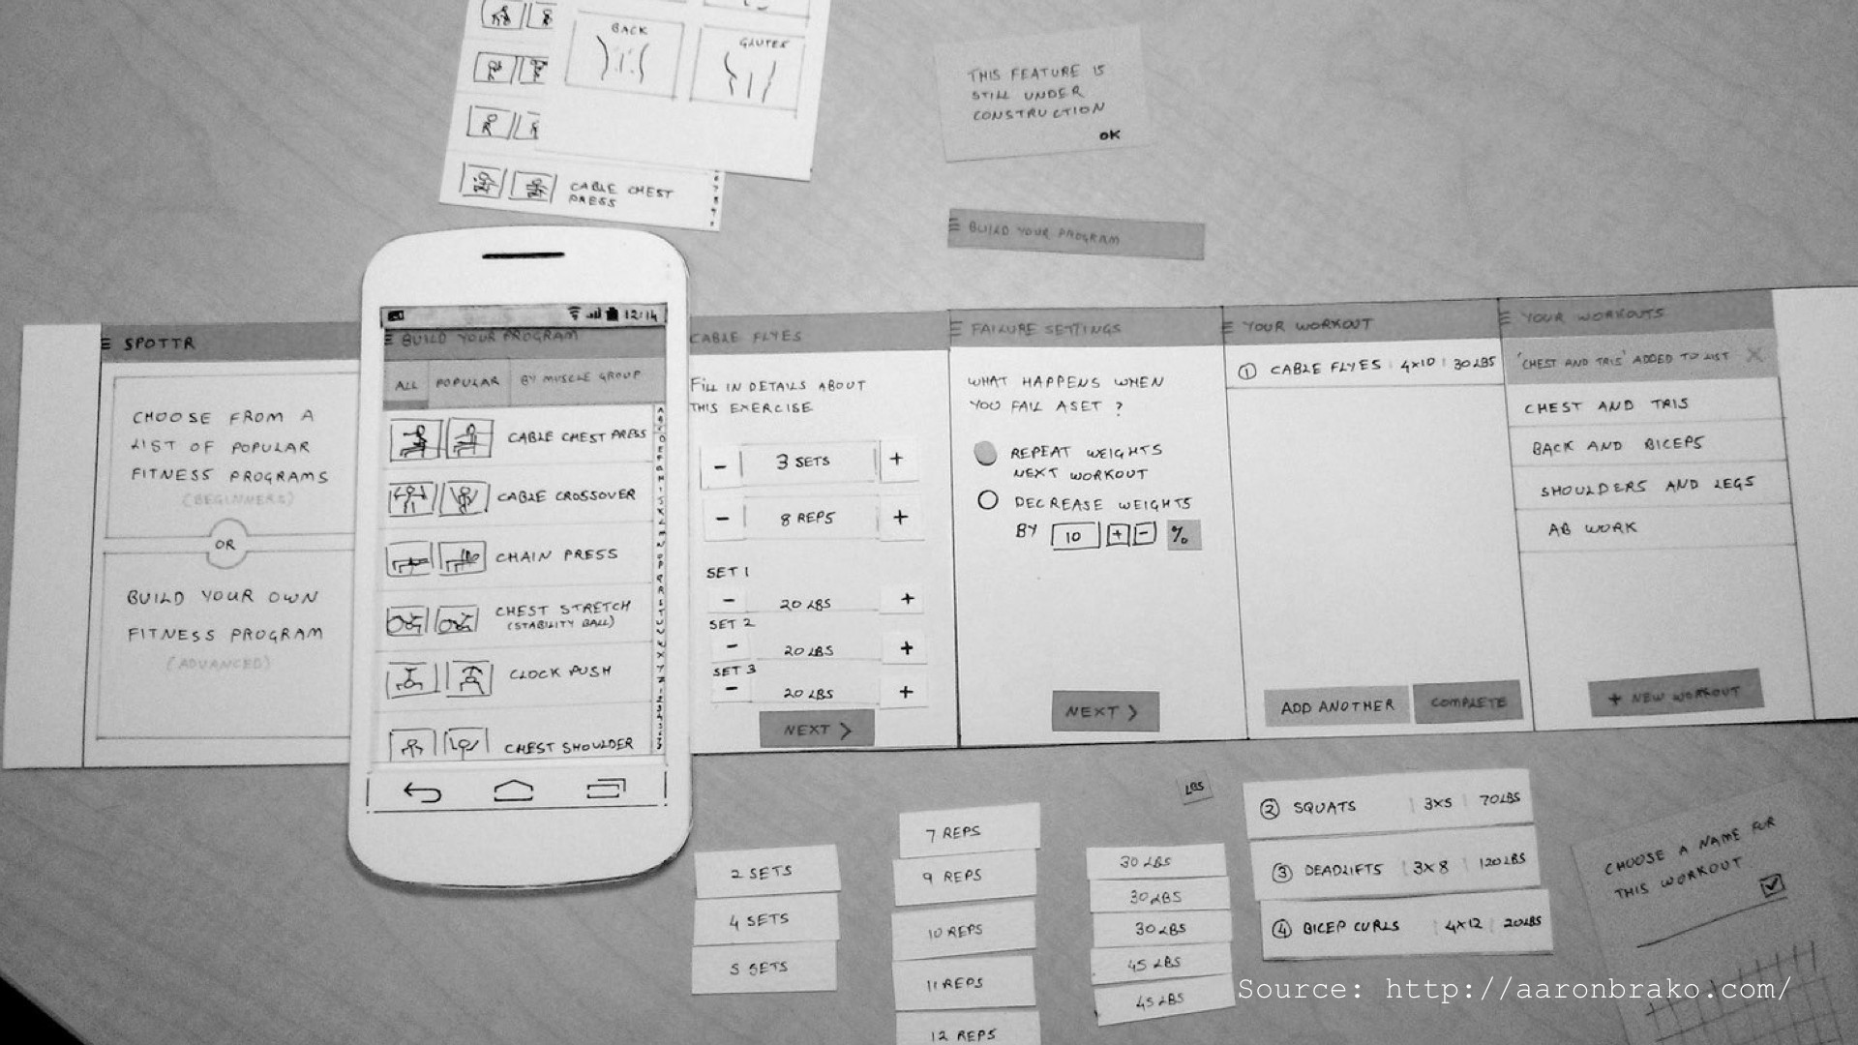

Slide 29
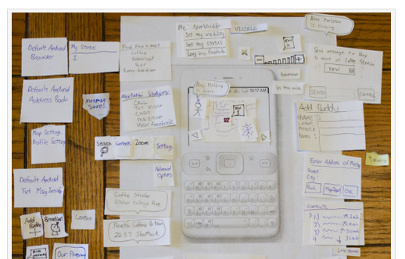
http://academiccomputing.wordpress.com/2012/06/19/what-about-hci/

Slide 30
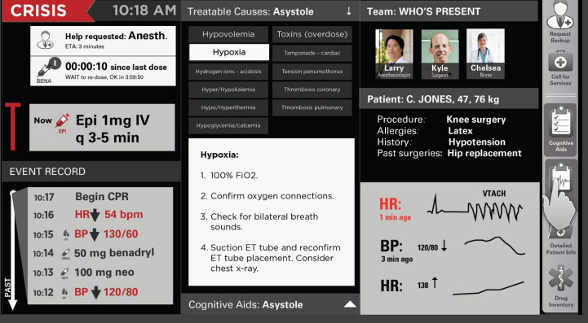
High Fidelity Prototype

Slide 31
High-fidelity prototyping
Uses materials that you would expect to be in the final product
Prototype looks more like the final system than a low-fidelity version
High-fidelity prototypes can be developed by integrating existing hardware and software components
Danger that users think they have a complete system…see compromises

Slide 32
Presentation and Critique
Presentation and critique is arguably the most important part of prototyping process
This is where we focus on quality
The goal is to find the best ideas
You present the strengths of your concept, and your peers highlight areas that need work or further clarification
That’s it—discuss, evaluate, and move on

Slide 33
Wizard-Of-Oz Prototyping...
...simulates machine behavior with human operators

Slide 34
Used initially to simulate speech recognition systems

Slide 35
Wizard of Oz
Make an interactive application without (much) code
Front end interface
(Remote) wizard controls user interface
Makes sense when it’s faster/cheaper/easier than making real thing
Get feedback from users people

Slide 36
Wizard of Oz Prototyping
Hi-fidelity: users think it’s more real
Low-fidelity: more license to suggest changes

Slide 37
Making a Wizard-Powered Prototype
Map out scenarios and application flow •
what should happen in response to user behavior? •
Put together interface “skeletons” •
Develop “hooks” for wizard input
Where and how the wizard will provide input
selecting the next screen, entering text, entering a zone, recognizing speech, etc.
remember that later you’ll need to replace with computer
Rehearse wizard role with a colleague

Slide 38
Wizards can be used throughout the development
They can be used with low fidelity as well as high fidelity

Slide 39
Disadvantages
Simulations may misrepresent otherwise imperfect tech
May simulate technologies that do not exist (and may never)
Wizards require training and can be inconsistent
Some features (and limitations) are difficult/ impossible to simulate effectively

Slide 40
Video Prototyping
Cheap and fast
Great communication tools
Helps achieve common ground
Ideally, portable and self-explanatory
Can serve as a ‘spec’ for developers
Ties interface designs to tasks
Aligns and orients interface choices
Makes sure you have a complete interface
And that there’s nothing extra

Slide 41
Video prototypes can be any fidelity

Slide 42
What should the video show?
Like a storyboard, the whole task,
including motivation and success
Establishing shots and narrative help
Draw on tasks you’ve observed
Illustrate important tasks your system enables
Can help scope a minimum-viable product
Changes what design teams argue about
(in a good way)

Slide 43
Prototyping Techniques
Approaches to limiting prototype functionality
Vertical prototypes
Includes in-depth functionality for only a few selected features
Common design ideas can be tested in depth
Horizontal prototypes
Surface layers includes the entire user interface with no underlying functionality
A simulation; no real work can be performed

Slide 44
The Prototyping Process

Slide 45
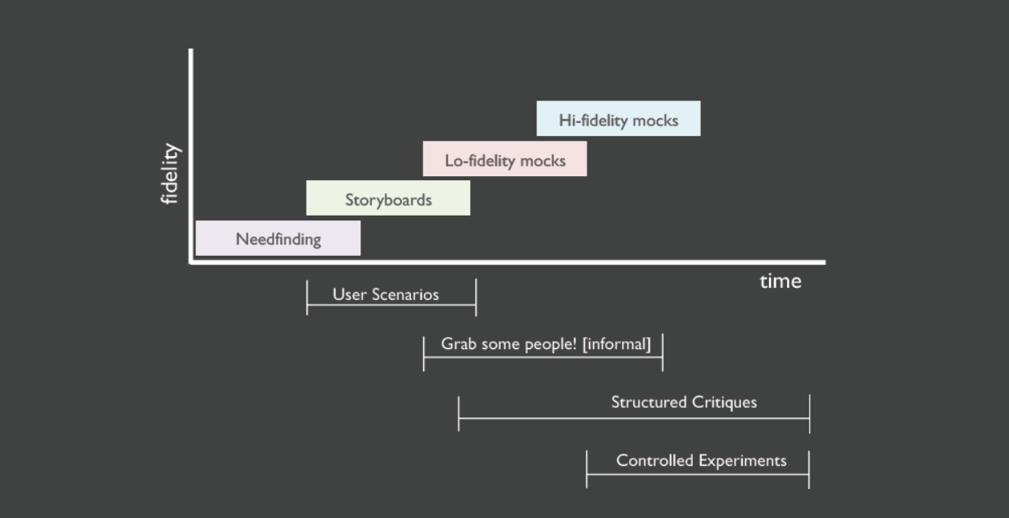

Slide 46
Must Read!
Perils of Prototyping
http://www.cooper.com/journal/2008/5/the_perils_of_prototyping

